Slide 1
Quantum Physics and Technology of Matter
“condensed matter physicists involve three basic components — electrons, ions, and photons — which can interact in unique and interesting ways to produce an incredible variety of phases of matter — metals, insulators, ferromagnets, anti-ferromagnets, superconductors, superfluids, ferroelectrics, semiconductors, glasses, topological phases, spin liquids, and more.”
Prof. D. Arovas, President of the Division of Condensed Matter Physics, APS

Slide 2
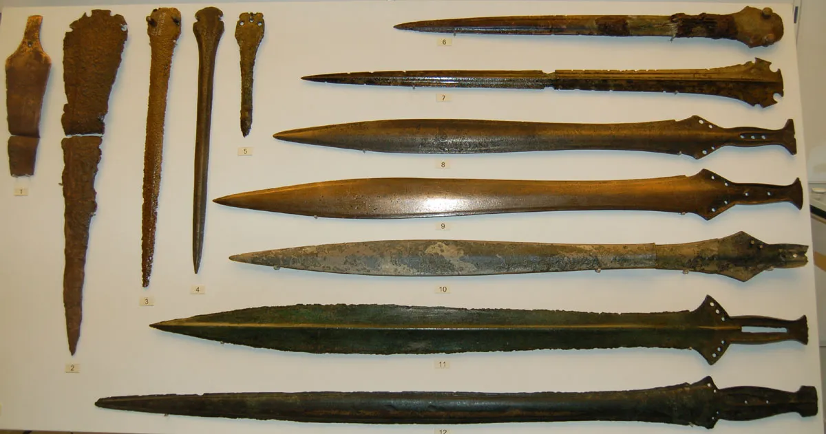

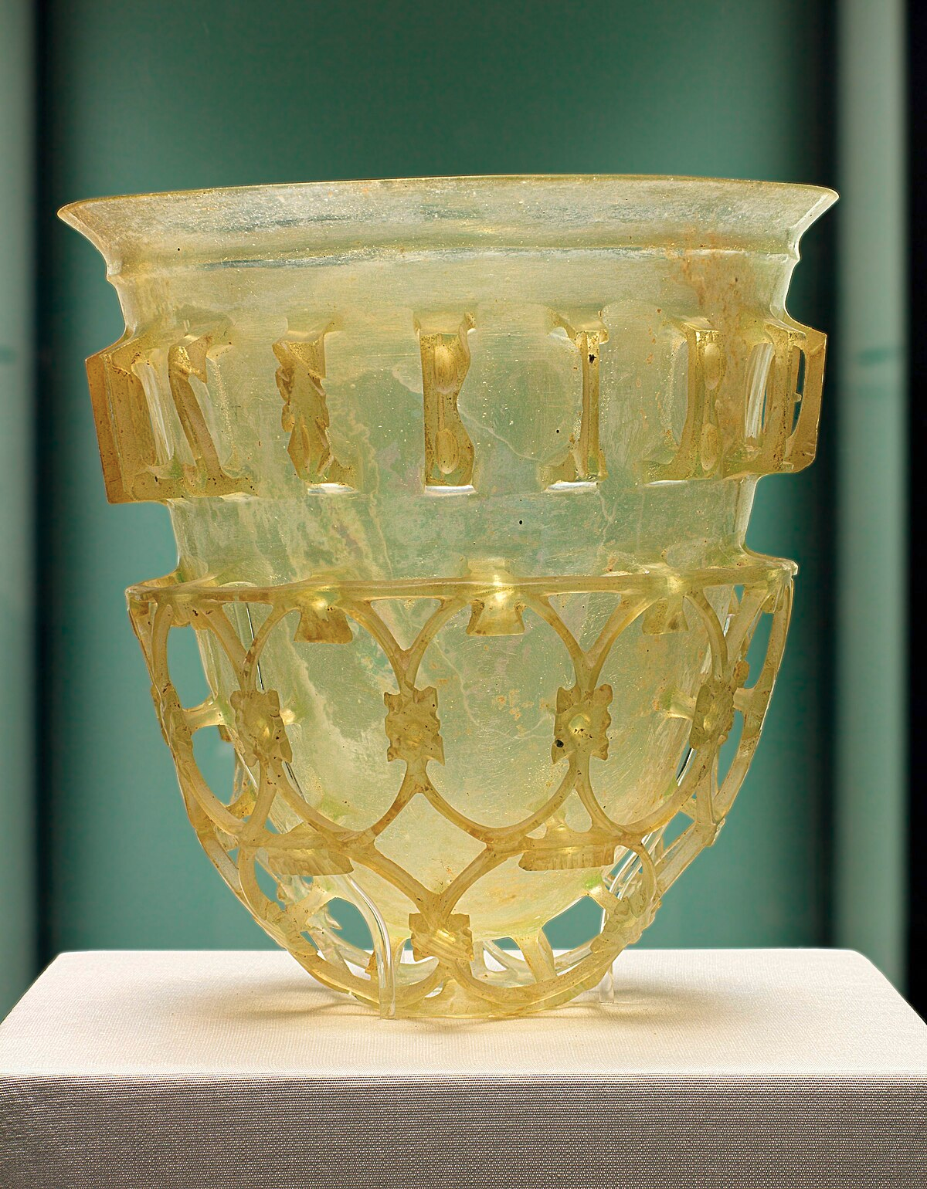
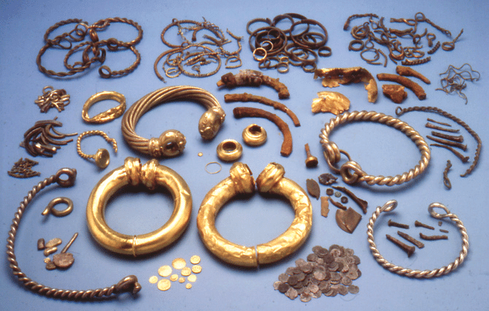
Quantum Physics and Technology of Matter
Nuovi materiali da … sempre

Slide 3
Quantum Physics and Technology of Matter
Dagli atomi alla materia condensata
atomi
molecole
solidi
Aumento della complessità
Ma ...
“more is different”
P.W. Anderson, Science, vol. 177, 4047 (1972)

Slide 4
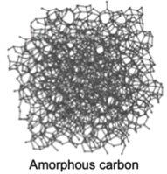
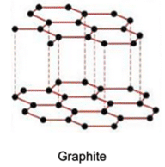
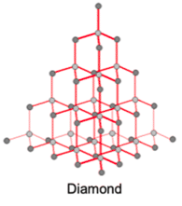
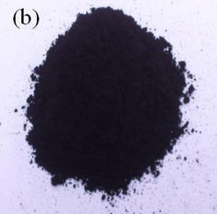
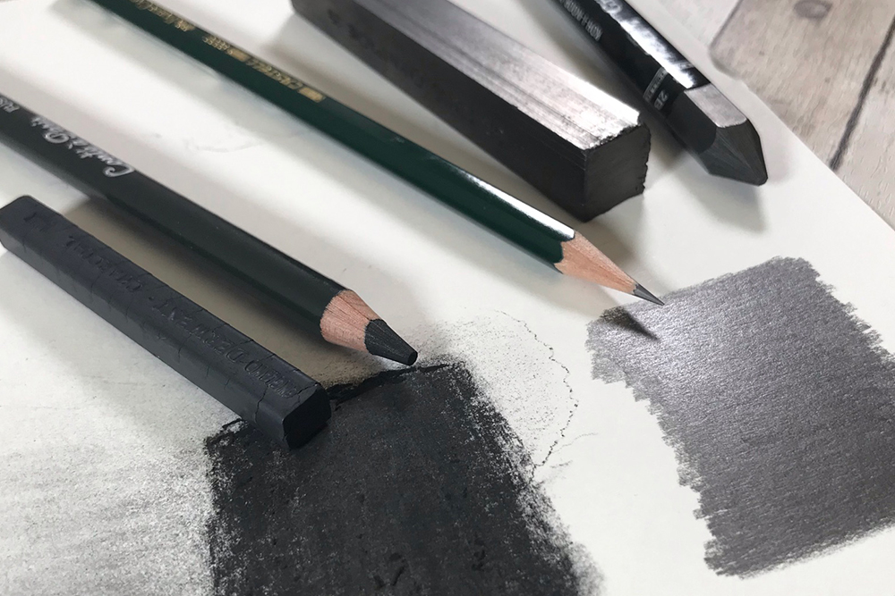

Quantum Physics and Technology of Matter
“more is different”: il Carbonio

Slide 5
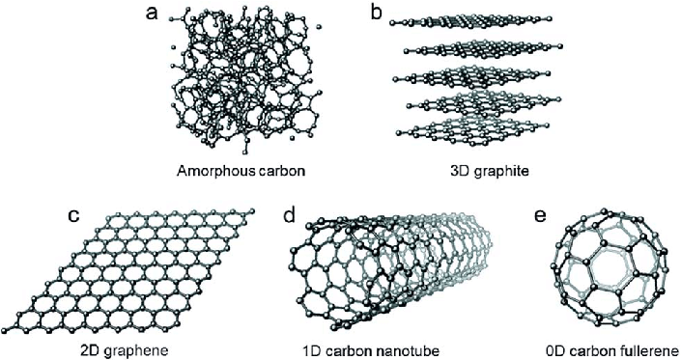
Quantum Physics and Technology of Matter
“more is different”: il Carbonio

Slide 6
Quantum Physics and Technology of Matter
Dagli atomi alla materia condensata
atomi
molecole
solidi
Aumento della complessità
Quasi-particelle
Fenomeni collettivi
Fononi
Plasmoni
Polaritoni
Eccitoni
...
Transizioni metallo-isolante
Superconduttività
Superfluidità
Ferromagnetismo
...

Slide 7
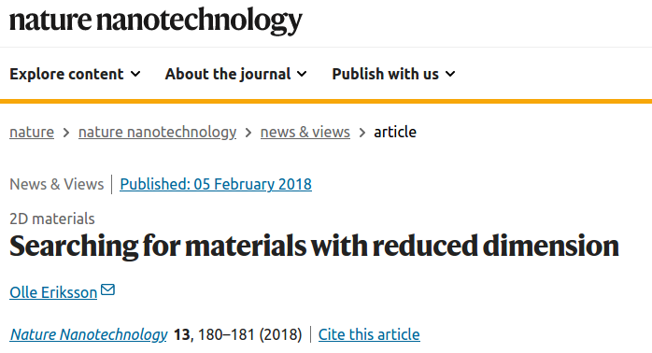
Quantum Physics and Technology of Matter
Dagli atomi alla materia condensata
atomi
molecole
solidi
Aumento della complessità
Bassa dimensionalità e nanoparticelle

Slide 8
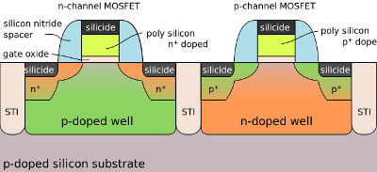
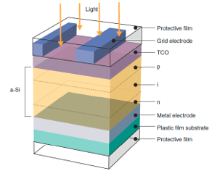
Quantum Physics and Technology of Matter
L’età dei semiconduttori

Slide 9
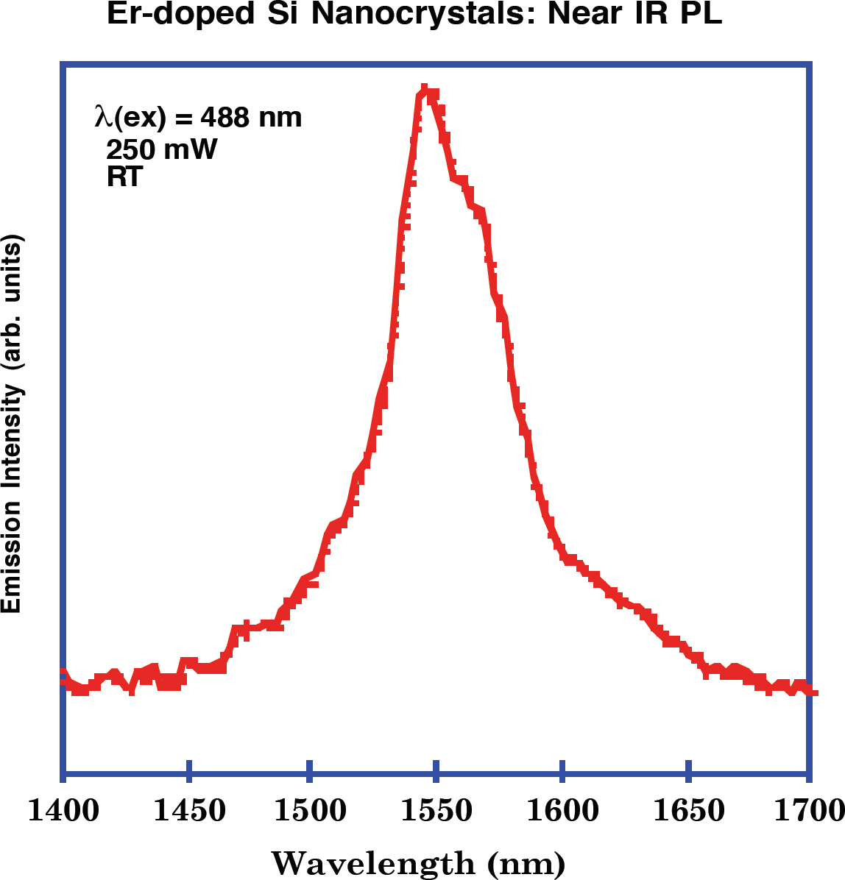
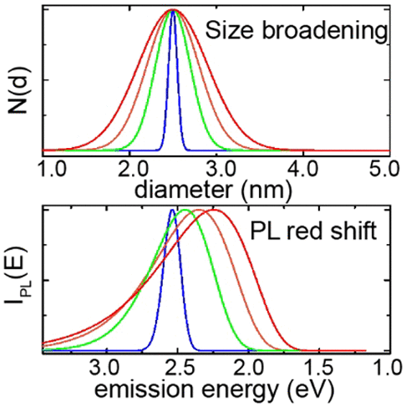
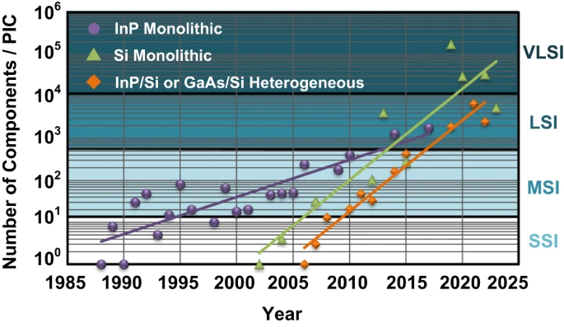
Quantum Physics and Technology of Matter
Manipolare la luce: la fotonica

Slide 10
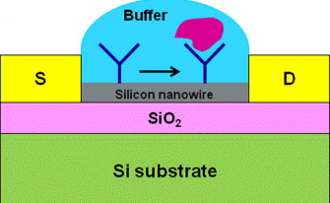
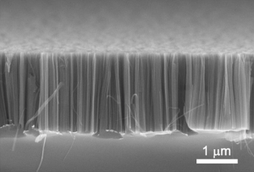
Quantum Physics and Technology of Matter
Il mondo dei sensori
Monitorare l’ambiente esterno tramite la variazione di una propietà fisica del dispositivo
Temperatura, luce, umidità, accelerazione, movimento, pressione, suono, ...
Specie chimiche organiche, inorganiche, biologiche

Slide 11
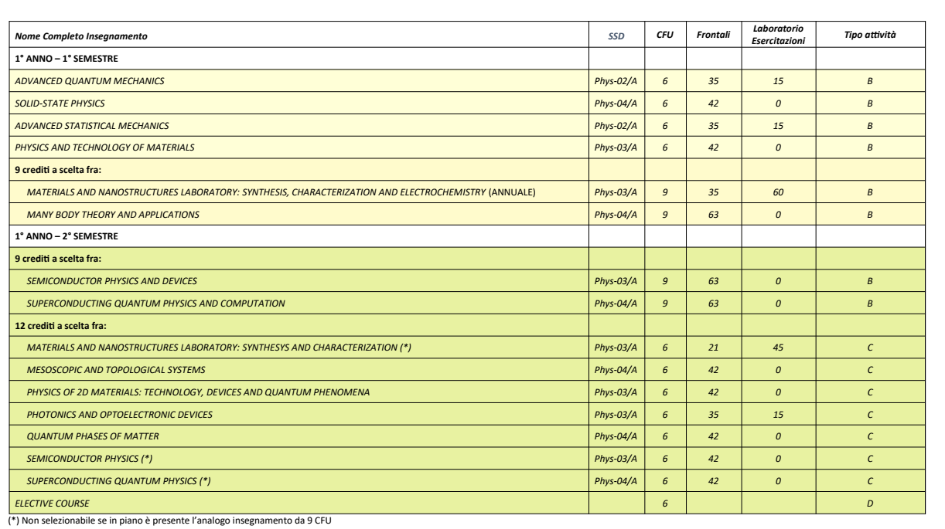
Quantum Physics and Technology of Matter

Slide 12
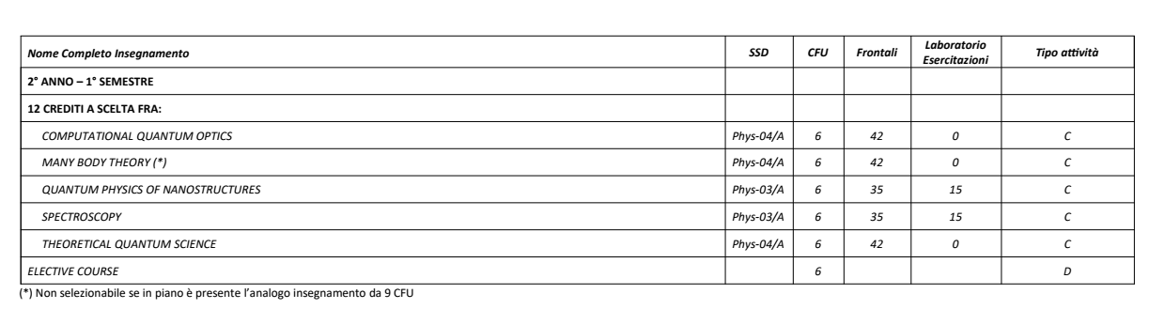
Quantum Physics and Technology of Matter

Slide 13
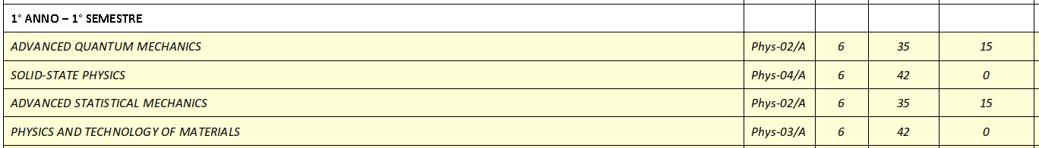
Quantum Physics and Technology of Matter
Advanced Quantum Mechanics
Solid State Physics
Advanced Statistical Mechanics
Physics and Technology of Materials

Slide 14
Quantum Physics and Technology of Matter
Materials and Nanostructures Laboratory
Many Body Theory and Applications

Slide 15
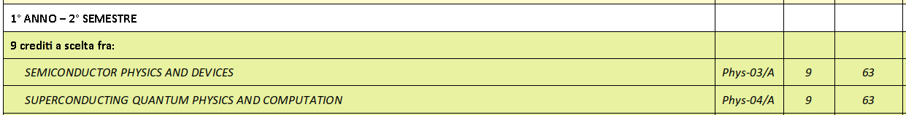
Quantum Physics and Technology of Matter
Semiconducor Physics and Devices
Superconducting Quantum Physics and Comutation

Slide 16
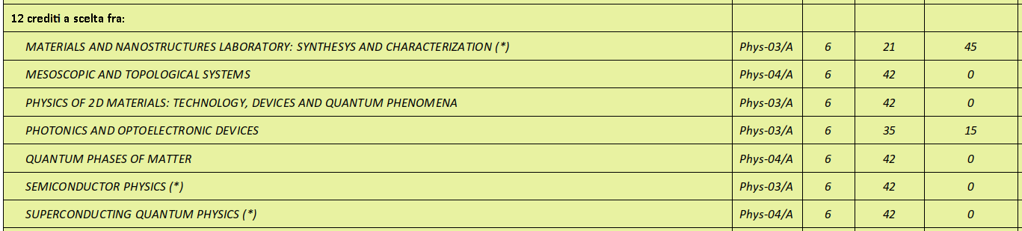
Quantum Physics and Technology of Matter
Materials and Nanostructure Laboratory (6 CFU)
Physics of 2D Materials
Photonics and Optoelectronic Devices
Semiconductor Physics (6 CFU)

Slide 17
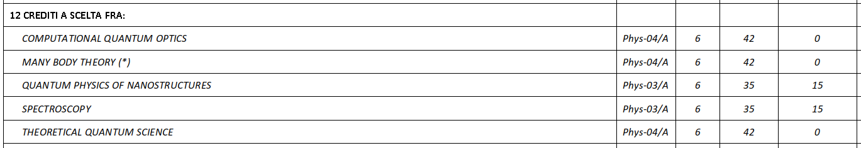
Quantum Physics and Technology of Matter
Quantum Physics of Nanostructures
Spectroscopy

Slide 18
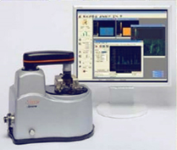
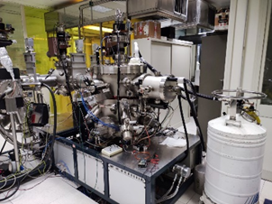
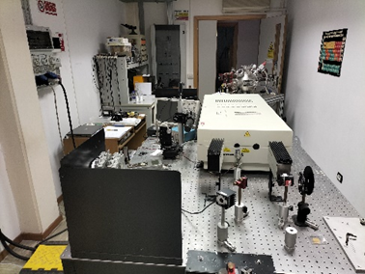
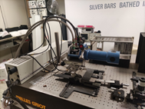
Quantum Physics and Technology of Matter
Laboratori
Microscopio a forza atomica
Epitassia a fascio molecolare
Laser di potenza
Laboratorio Spettroscopie Ottiche

Slide 19
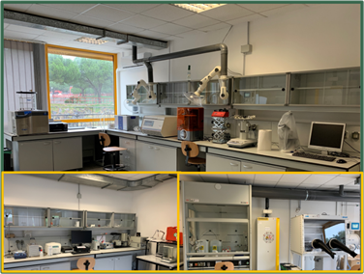
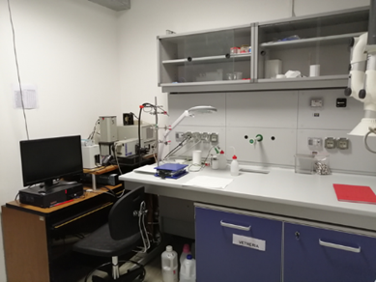
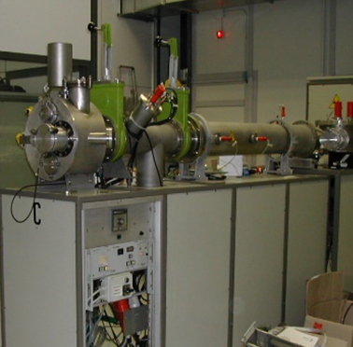
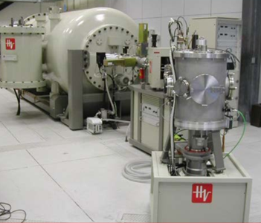
Quantum Physics and Technology of Matter
Laboratori
Nano 2D²
NanoSPES
Impiantatore ionico
Singletron

